Slide 1


Alexander Leano
19/03/2024

Slide 2

Outline
Executive Summary
Introduction
Methodology
Results
Conclusion
Appendix

Slide 3
Executive Summary
Summary of methodologies
Data collection via API and Web Scraping
Exploratory Data Analysis with Data Visualization
Exploratory Data Analysis with SQL
Interactive Map with Folium
Dashboards with Plotly Dash
Predictive Analysis
Summary of all results
Exploratory Data Analysis results
Interactive maps and Dashboard
Predictive results

Slide 4
Introduction
Project background and context
The project aims to predict if the Falcon 9 first stage will successfully land.
Falcon 9 rocket launch cost 62 million dollars when other providers cost upward of 165 million dollars each.
The price difference is explained by the fact that SpaceX can reuse the first stage.
By determining if the stage will land, It is possible to determine the cost of a launch.
This information is interesting for another company if it wants to compete with SpaceX for a rocket launch.
Problem to be solved
Identification of factors that influence the landing outcome.
Find the relationship between variables and how they affect the outcome.
Increase the probability of landing success by finding the best condition needed.

Slide 5

Section 1

Slide 6
Methodology
Executive Summary
Data collection methodology:
Request data from the SpaceX API (https://api.spacexdata.com/v4/rockets/).
Web scrapping from Wikipedia.
Perform data wrangling
Dropped unnecessary columns and labeled them for classification models.
Perform exploratory data analysis (EDA) using visualization and SQL
Perform interactive visual analytics using Folium and Plotly Dash
Perform predictive analysis using classification models
Find the best hyper-parameters, compare the different models

Slide 7
Data Collection
Dataset collected by REST API:
URL: https://api.spacexdata.com/v4/rockets/
Using of get request, decode the response content as JSON and turn it into a pandas data frame using the json_normalize() method. Cleaned data, checked and filled in missing values that were needed.
Web scraping:
List of Falcon 9 and Falcon Heavy launches (9th June 2021). URL: https://en.wikipedia.org/w/index.php?title=List_of_Falcon_9_and_Falcon_Heavy_launches&oldid=1027686922
Use of BeatifulSoup for extraction of record as HTML table, parsing and converted to a pandas data frame for further analysis

Slide 8
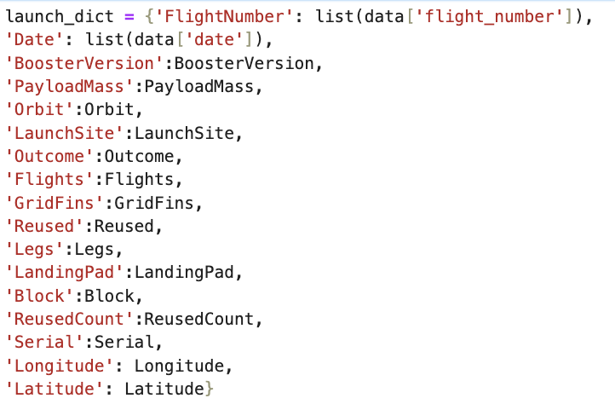
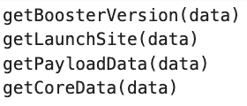
Data Collection – SpaceX API
1. Getting a response from API
4. Create a dictionary with data
5. Create a dataframe
2. Convert response to JSON file
6. Filter dataframe
3. Convert response to JSON file
7. Export to file

Slide 9
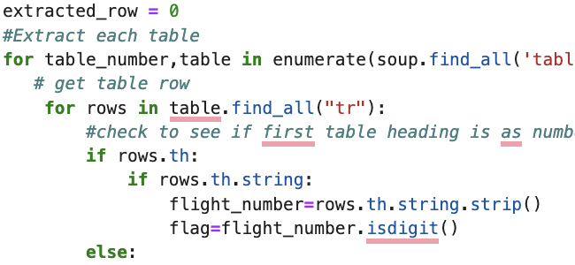
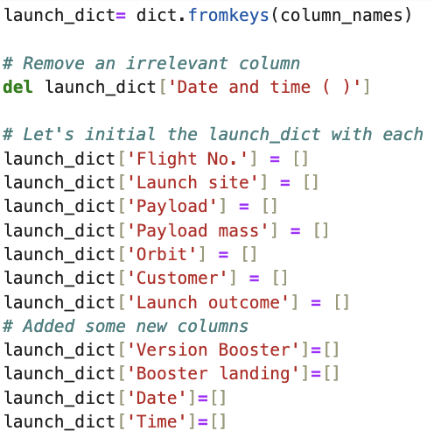
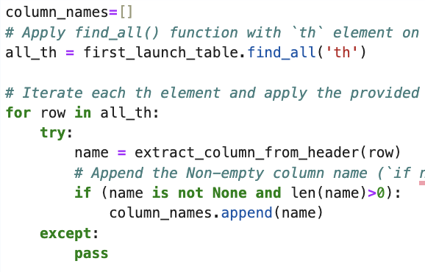
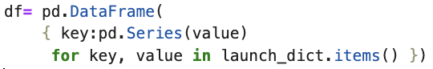
Data Collection - Scraping
1. Getting a response from HTML
6. Add data to keys
5. Create a dictionary with data
2. Create a BeautifulSoup Object
3. Find all tables
See the notebook for the rest of code
4. Get column names
7. Create dataframe
7. Export to file

Slide 10
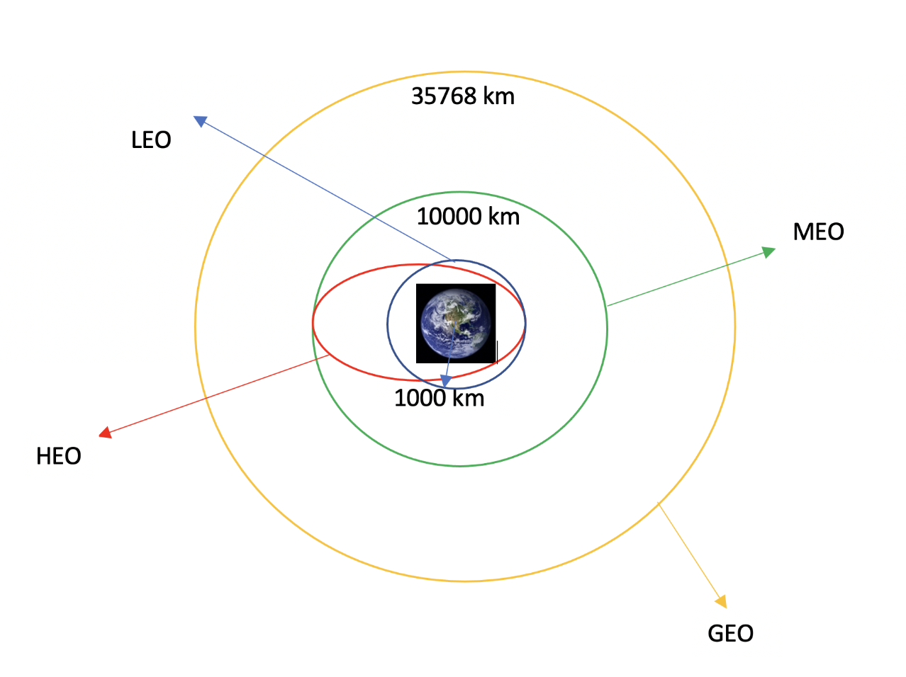
Data Wrangling
Data Wrangling is the process of cleaning and unifying complex data sets for easy access and Exploratory Data Analysis (EDA)
There were several cases where the booster did and did not land successfully:
Success: True Ocean, True RTLS, True ASDS
Failure: False Ocean, False RTLS, False ASDS
It was necessary to transform the outcome launch into a new categorical variable.
Some exploratory analysis was performed to have a better understanding of the occurrence of each orbit.

Slide 11
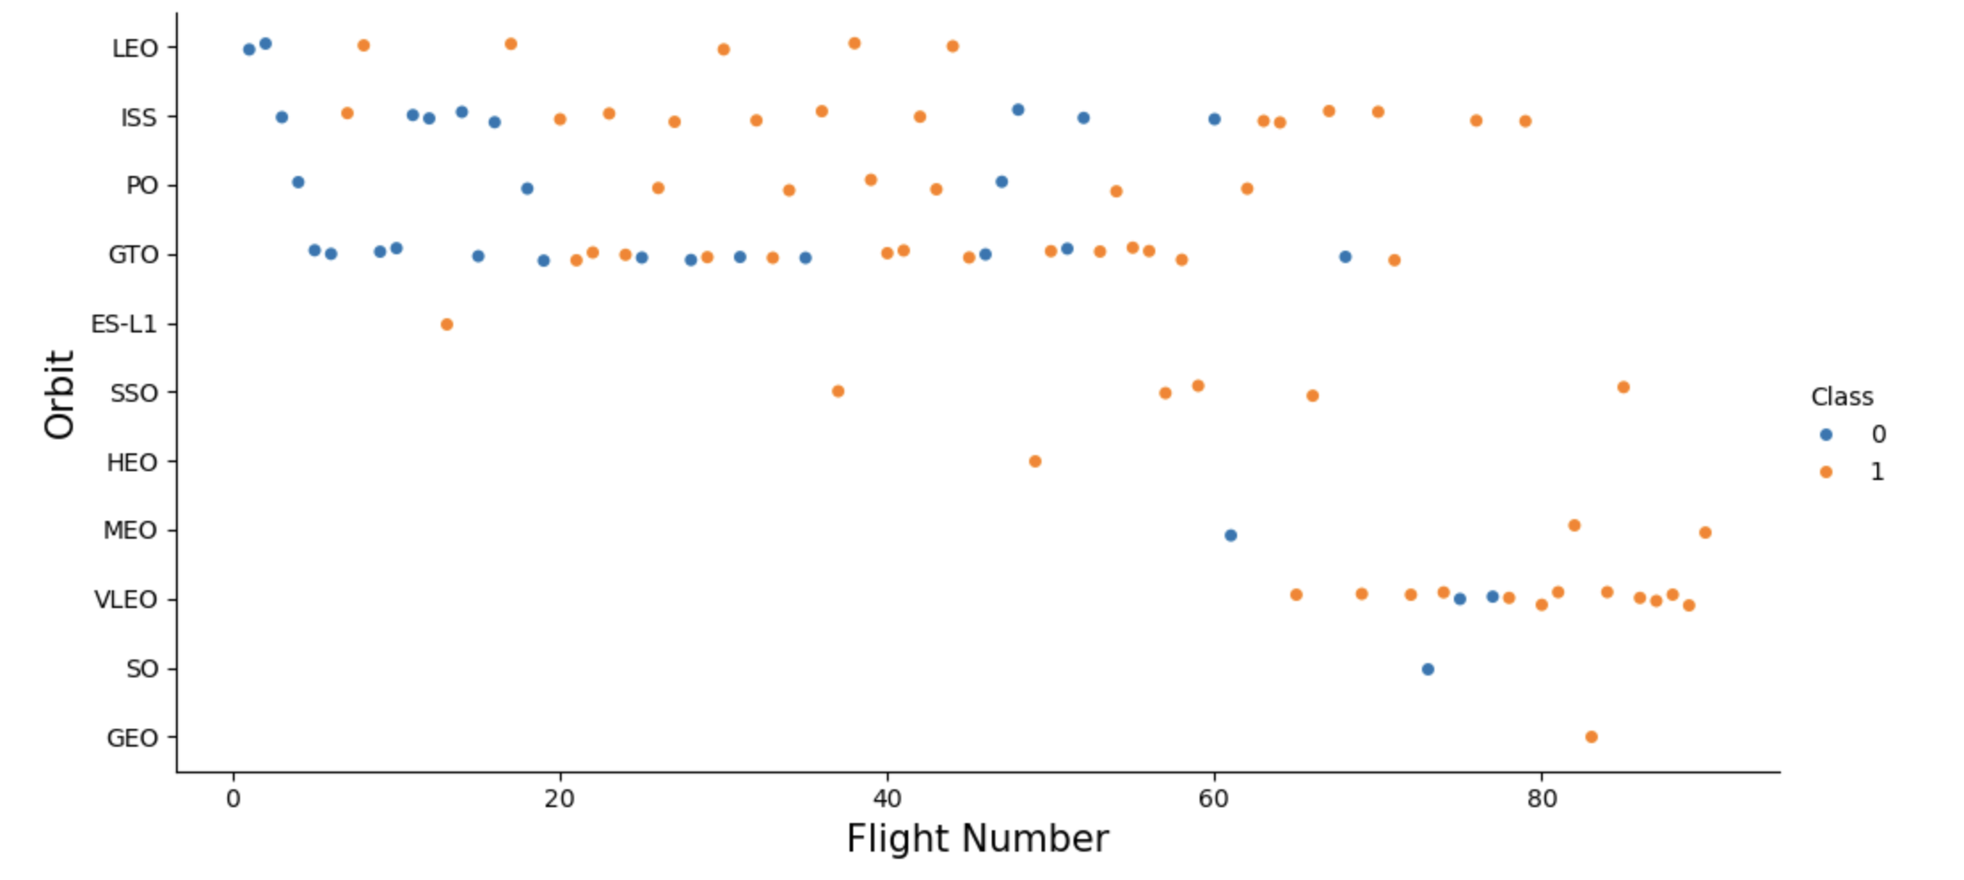
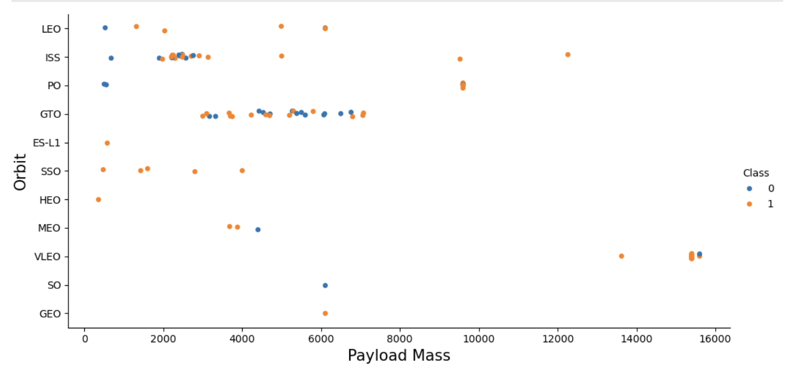
EDA with Data Visualization
Different scatter plots were graphed to find the relationship between variables:
Payload and Flight Number
Launch Site and Flight Number
Payload and Launch Site
Orbit and Flight Number
Success Rate and Orbit type
Orbit Type and Payload Mass
Scatter plots show which factors most affect the success of the landing outcomes. The correlation.
Bar graph which shows the relationship between numerical and categoric variables:
Success Rate vs Orbit
Line Graph which shows trends and makes predictions for unseen data:
Success rate vs Year

Slide 12
EDA with SQL
SQL queries were performed:
Display the names of the unique launch sites in the space mission
Display 5 records where launch sites begin with the string 'CCA’.
Display the total payload mass carried by boosters launched by NASA (CRS)
Display average payload mass carried by booster version F9 v1.1
List the date when the first successful landing outcome in the ground pad was achieved.
List the names of the boosters which have success in drone ships and have payload mass greater than 4000 but less than 6000kg
List the total number of successful and failed mission outcomes
List the names of the booster versions which have carried the maximum payload mass.
List the records that will display the month names, failure outcomes in drone ship, booster versions, and launch site for the months in the year 2015.
Rank the count of landing outcomes (such as Failure (drone ship) or Success (ground pad)) between the date 2010-06-04 and 2017-03-20, in descending order.

Slide 13
Build an Interactive Map with Folium
For visualization of launch sites, a marker with a circle around and a label with the name was added.
Green and Red markers were added to indicate the launch outcome( success or failure)
Using the Haversine’s formula for distance calculation was used to answer the following question:
How close are the launch sites to railways, highways, and coastlines?
How close are the launch sites to nearby cities?
Some lines with labels were added to indicate these distances.

Slide 14
Build a Dashboard with Plotly Dash
An interactive dashboard with Plotly Dash was built to plot graphs with different data. The components were:
Dropdown: allows users to choose all launch sites or a specific one (dash_core_components.Dropdown)
Pie chart: shows the total successful launches count for all sites and the success and failed counts for a specific site if it was chosen with the dropdown component. (plotly.express.pie)
RangeSlider: Allows users to select a payload mass in a fixed range (dash_core_components.RangeSlider).
Scatter chart: Shows the relationship between Success and Payload Mass (plotly.express.scatter)

Slide 15
Predictive Analysis (Classification)
Classification models used:
Logistic regression
Support Vector Machine
Decision tree
K-nearest neighbors
Model Evaluation
Comparison of results
Check the accuracy of each model.
Tune hyperparameters for each ML model.
Plot the confusion matrix
Data preparation and standardization
Load
Transform
Set the parameters for each algorithms for GridSearchCV
Different accuracy score were used.
Split into training and test datasets.
Fit de models

Slide 16
Results
The results will be categorized into 3 main results:
Exploratory data analysis results
Interactive analytics demo in screenshots
Predictive analysis results

Slide 17

Section 2

Slide 18
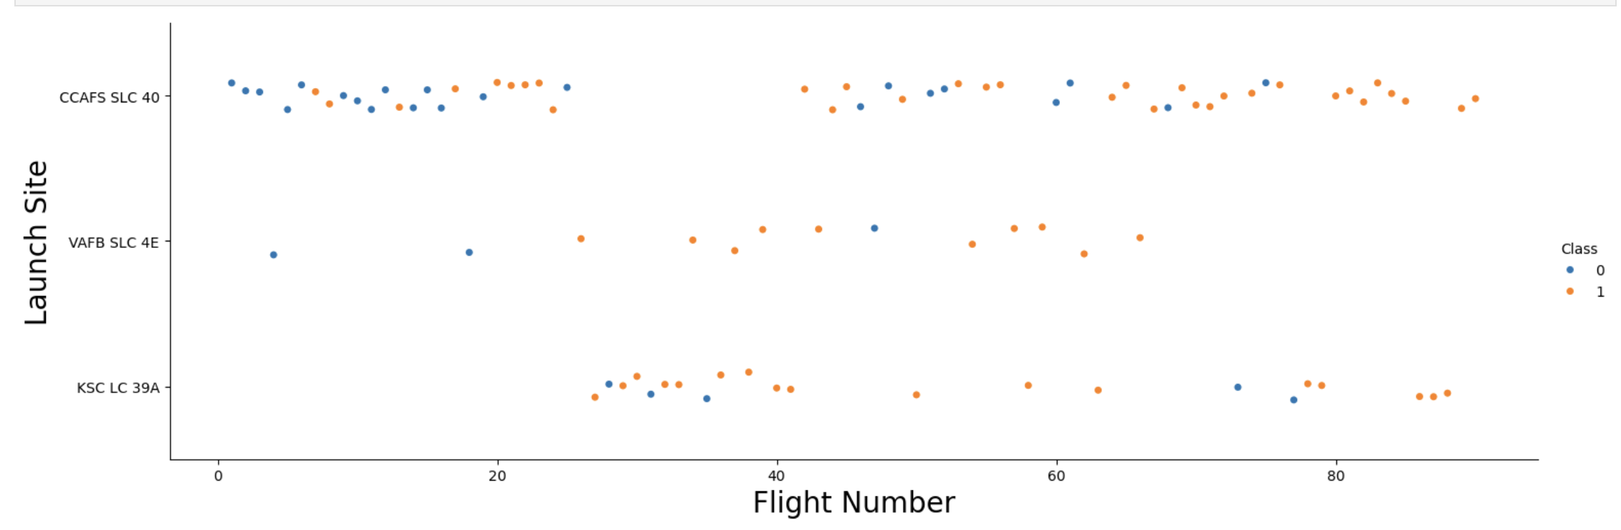
Flight Number vs. Launch Site
The earliest flights all failed while the latest flights all succeeded in each Launch Site.
The general success rate improved with each launch.
CCAFS SLC 40 launch site has around the half total number of launches and the most recent ones were successful
VAFB SLC 4E and KSC LC 39A have higher success rates.

Slide 19
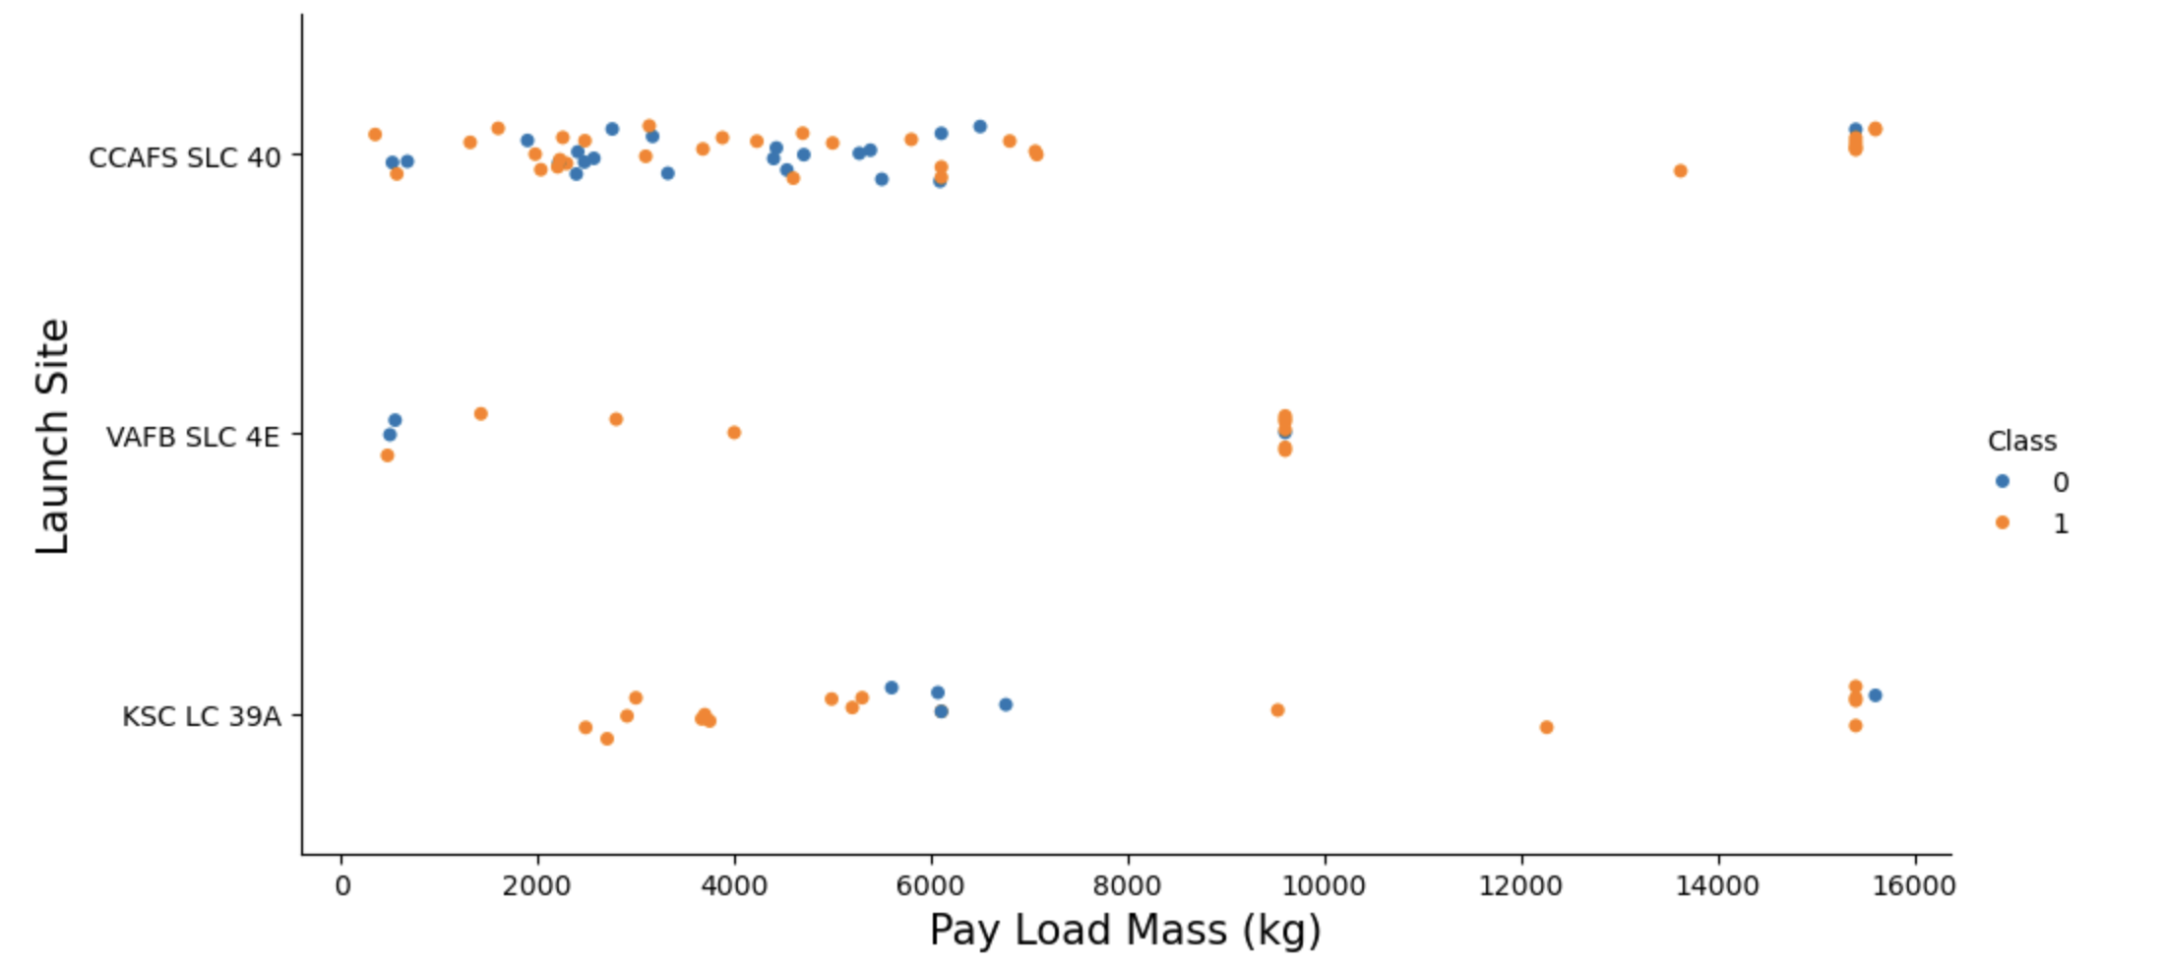
Payload vs. Launch Site
VAFB-SLC launch site there are no rockets launched for heavy payload mass(greater than 10.000kg)
Payloads over 8,000 kg have an excellent success rate.

Slide 20
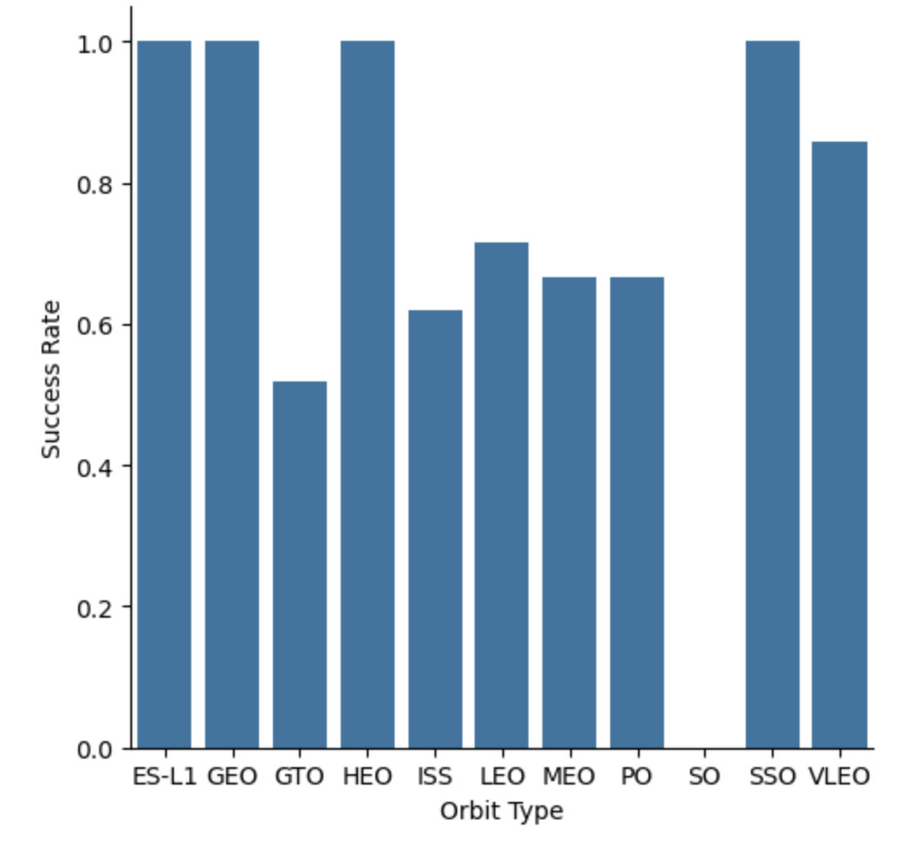
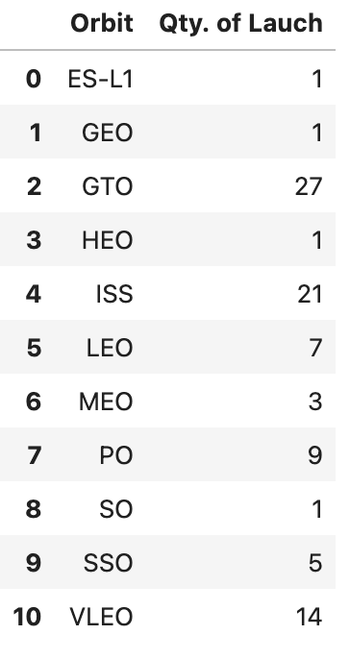
Success Rate vs. Orbit Type
Orbits with a 100% success rate have only one launch:
ES-L1, GEO, HEO
While there is one 100% success rate with more launches and is better to do statistics:
SSO
Orbits with 0% success rate and just 1 launch is:
SO
Orbits with a success rate between 50% and 85%:
GTO, ISS, LEO, MEO, PO

Slide 21
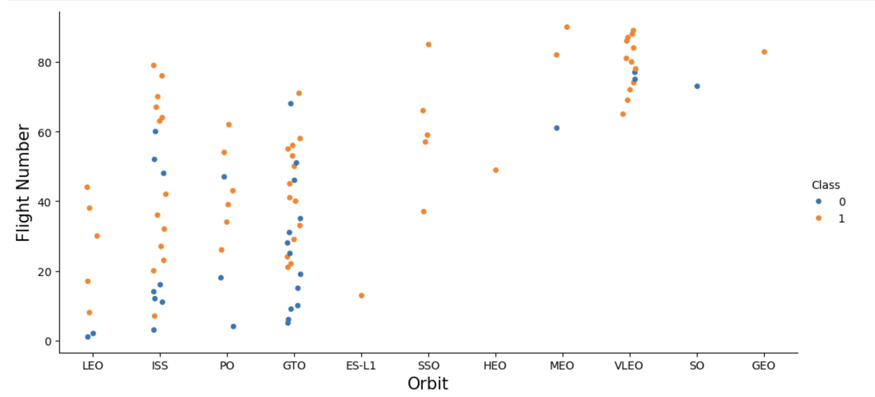
Flight Number vs. Orbit Type
LEO orbit success appears related to the number of flights;
There seems to be no relationship between flight numbers when in GTO orbit.

Slide 22
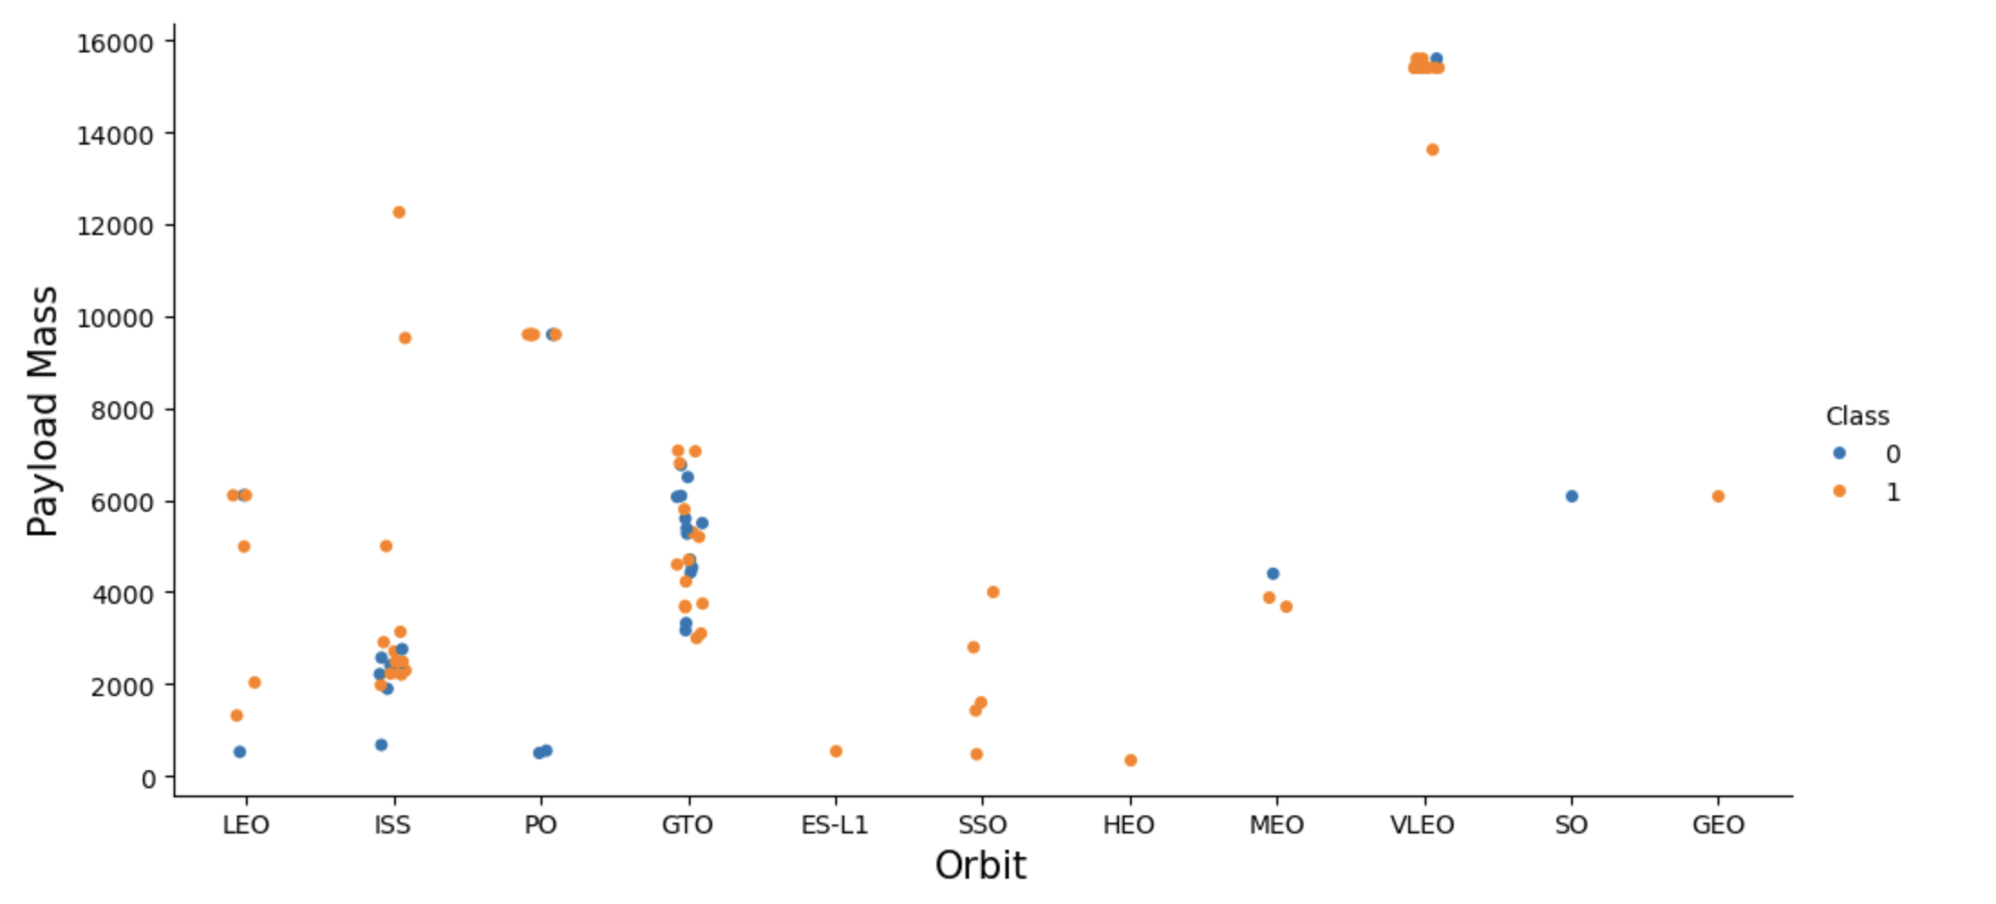
Payload vs. Orbit Type
Heavy payloads for a successful landing or positive landing rate are more likely for LEO, ISS, and Polar. And in the opposite for MEO and VLEO orbits.
For GTO cannot be distinguished this well as both positive landing rate and negative landing (unsuccessful mission), both there here.
Orbits that only has 1 occurrence should be excluded until have more date.

Slide 23
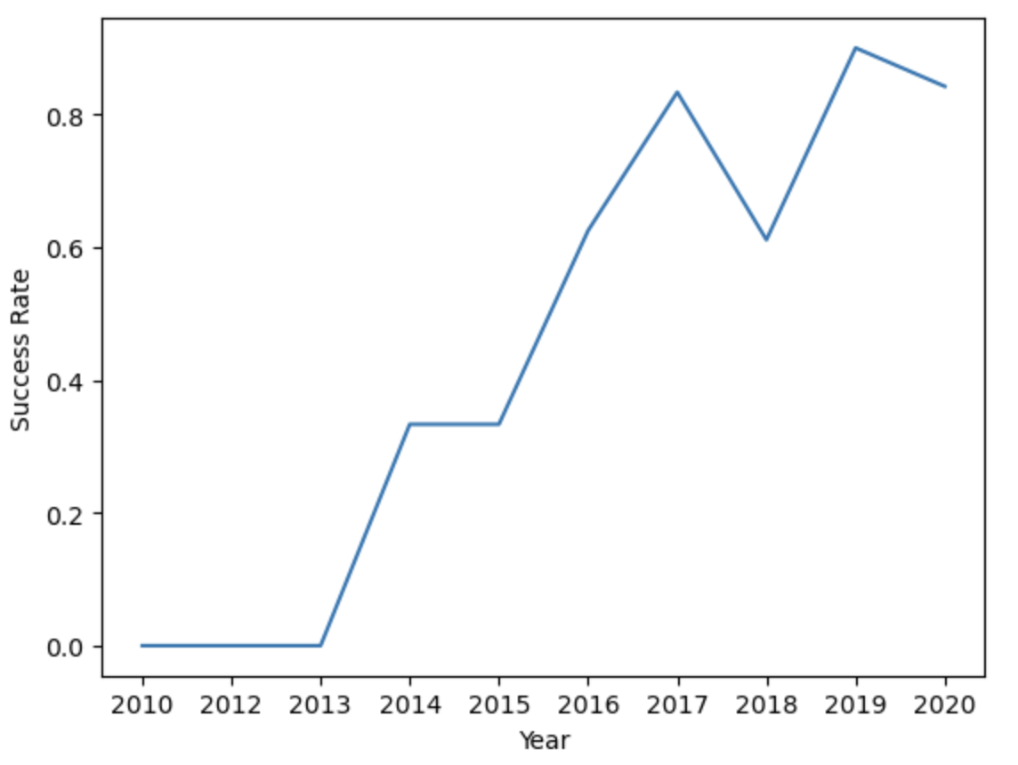
Launch Success Yearly Trend
From 2013 until 2017 the success rate keep increasing.

Slide 24
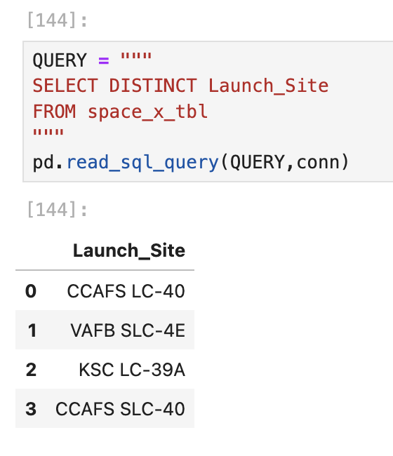
All Launch Site Names
The word distinct

Slide 25
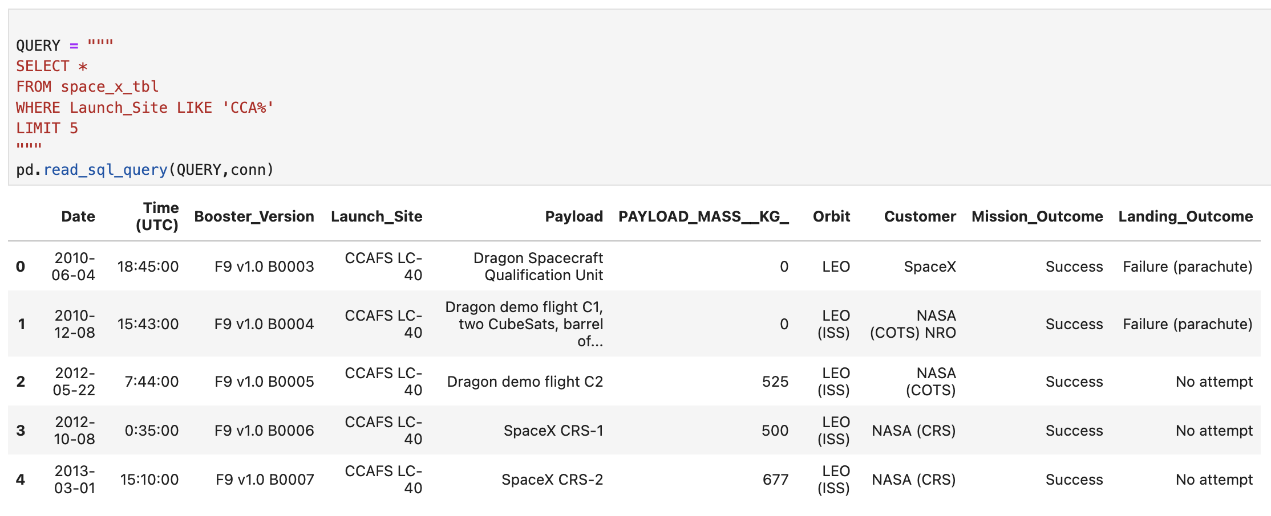
Launch Site Names Begin with 'CCA'
Find 5 records where launch sites begin with `CCA`
Present your query result with a short explanation here

Slide 26
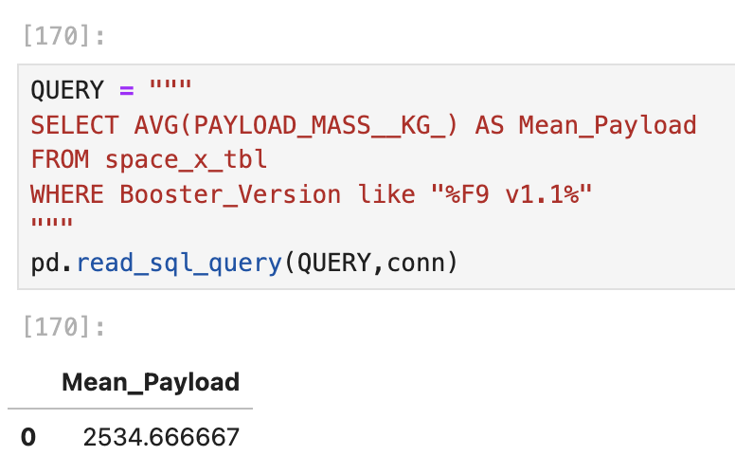
Total Payload Mass
Calculate the total payload carried by boosters from NASA
Present your query result with a short explanation here

Slide 27
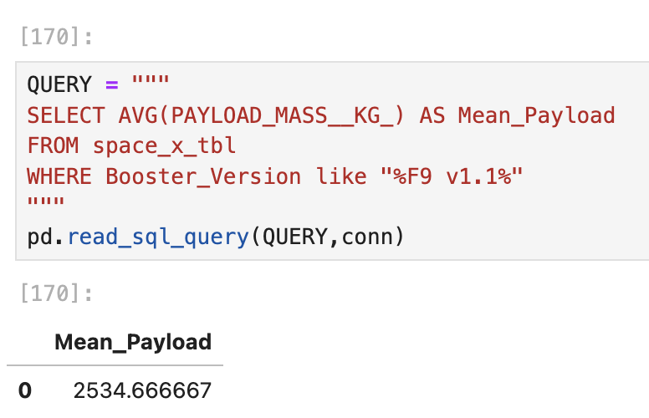
Average Payload Mass by F9 v1.1
Calculate the average payload mass carried by booster version F9 v1.1
Present your query result with a short explanation here

Slide 28
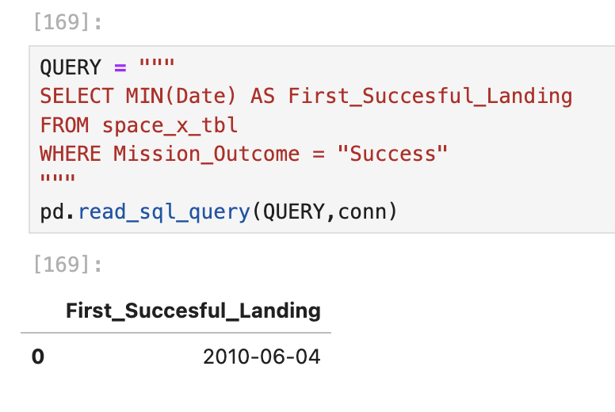
First Successful Ground Landing Date
Find the dates of the first successful landing outcome on ground pad
Present your query result with a short explanation here

Slide 29
Successful Drone Ship Landing with Payload between 4000 and 6000
List the names of boosters which have successfully landed on drone ship and had payload mass greater than 4000 but less than 6000
Present your query result with a short explanation here

Slide 30
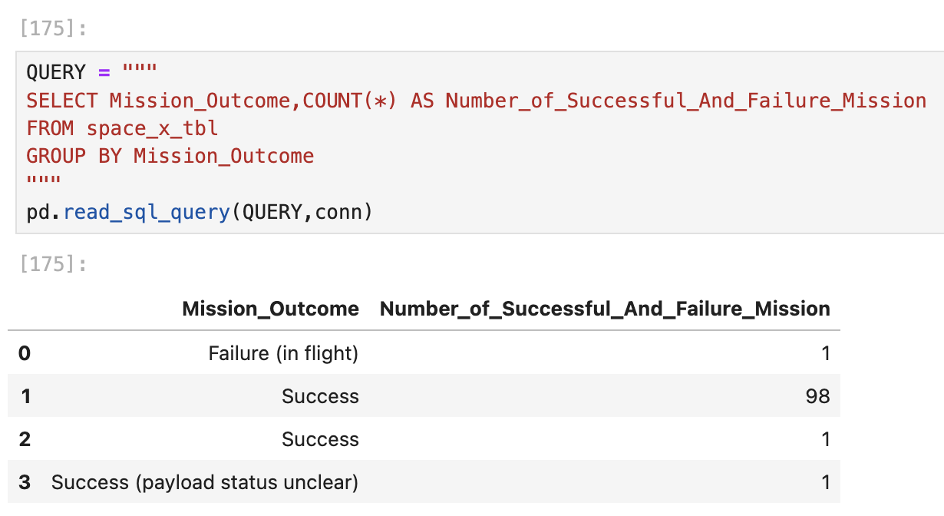
Total Number of Successful and Failure Mission Outcomes
Calculate the total number of successful and failure mission outcomes
Present your query result with a short explanation here

Slide 31
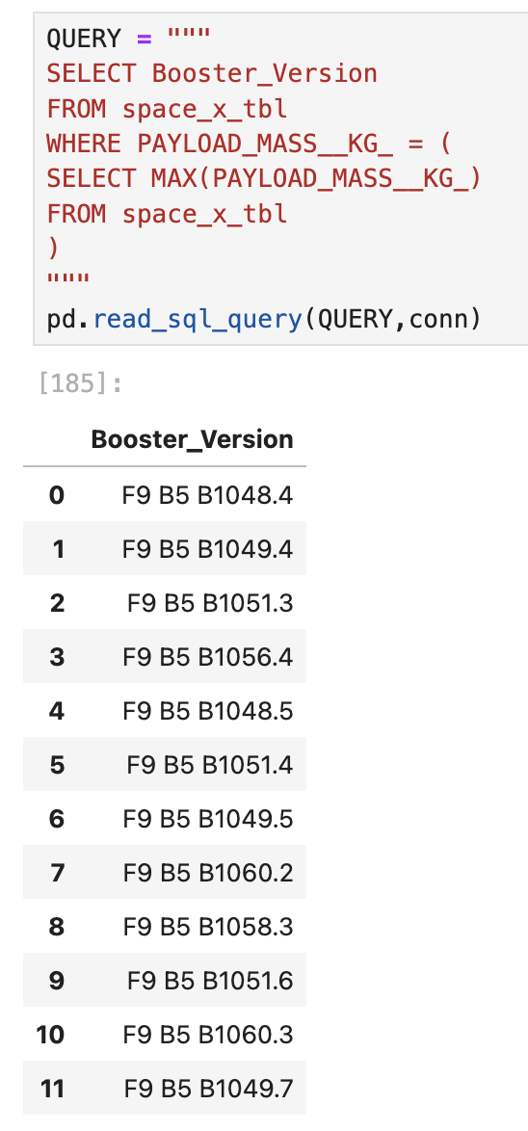
Boosters Carried Maximum Payload
List the names of the booster which have carried the maximum payload mass
Present your query result with a short explanation here

Slide 32
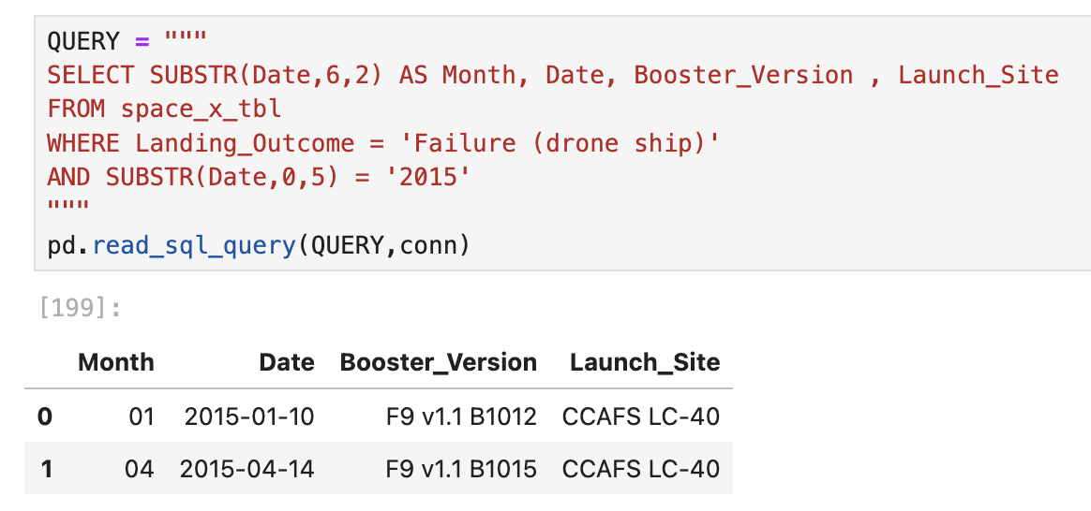
2015 Launch Records
List the failed landing_outcomes in drone ship, their booster versions, and launch site names for in year 2015
Present your query result with a short explanation here

Slide 33
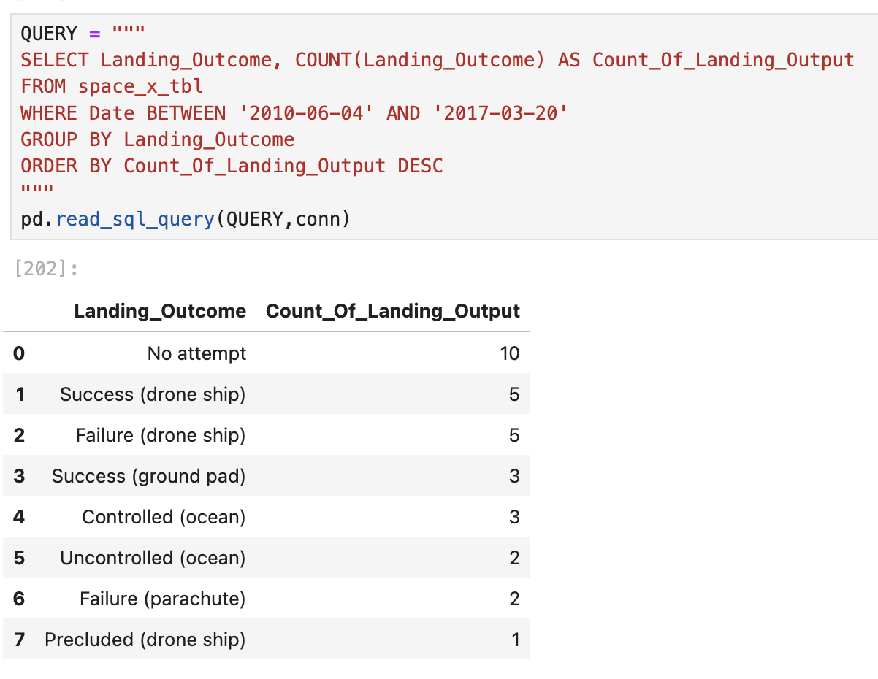
Rank Landing Outcomes Between 2010-06-04 and 2017-03-20
Rank the count of landing outcomes (such as Failure (drone ship) or Success (ground pad)) between the date 2010-06-04 and 2017-03-20, in descending order
Present your query result with a short explanation here

Slide 34

Section 3

Slide 35
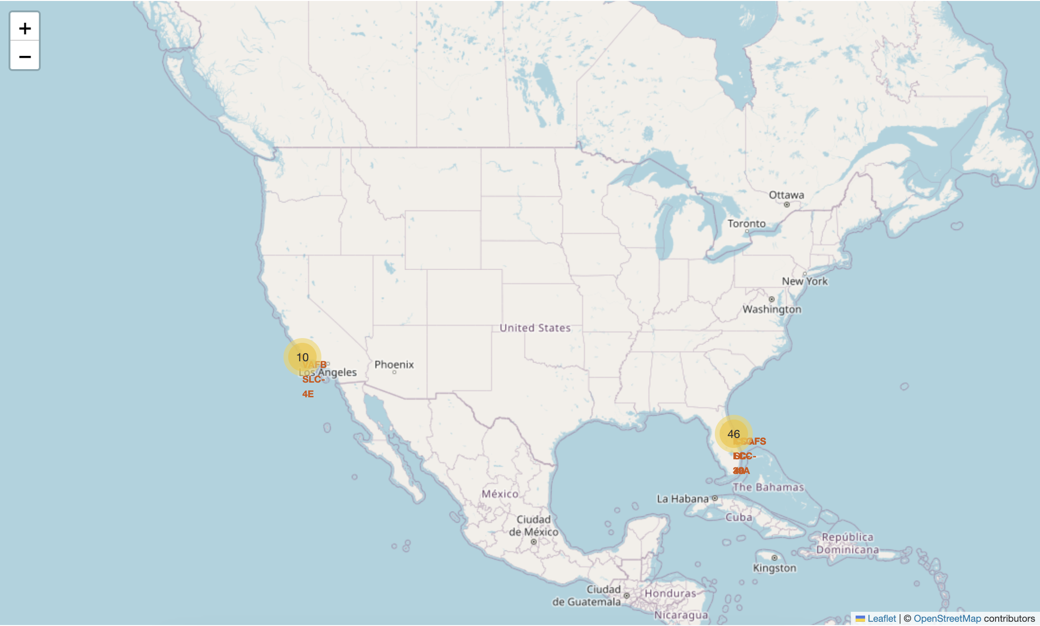
Folium Map - Launch Sites
Replace <Folium map screenshot 1> title with an appropriate title
Explore the generated folium map and make a proper screenshot to include all launch sites’ location markers on a global map
Explain the important elements and findings on the screenshot

Slide 36
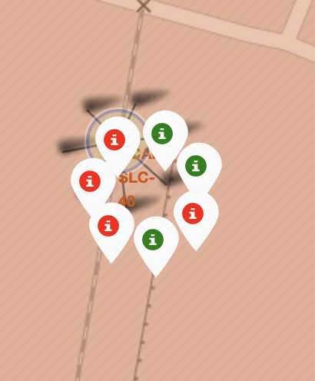
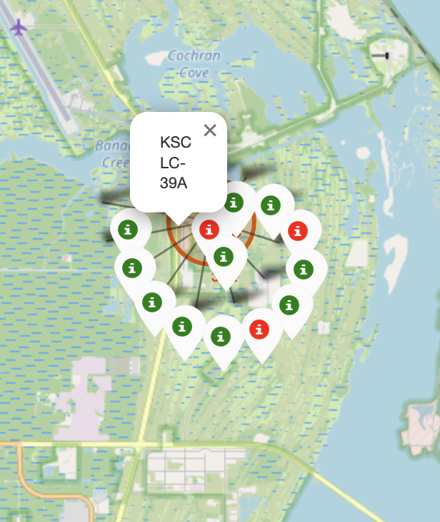
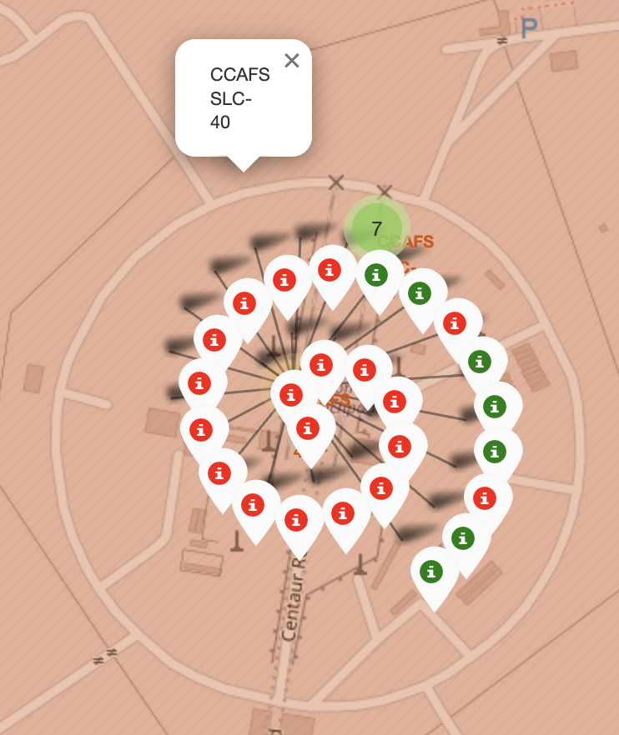
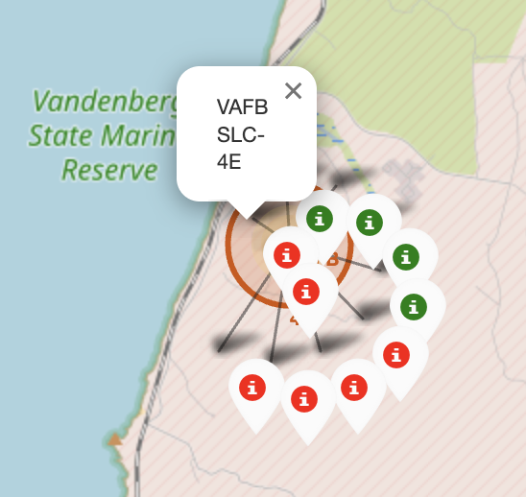
Folium Map – Launch sites with color marker
Replace <Folium map screenshot 2> title with an appropriate title
Explore the folium map and make a proper screenshot to show the color-labeled launch outcomes on the map
Explain the important elements and findings on the screenshot

Slide 37
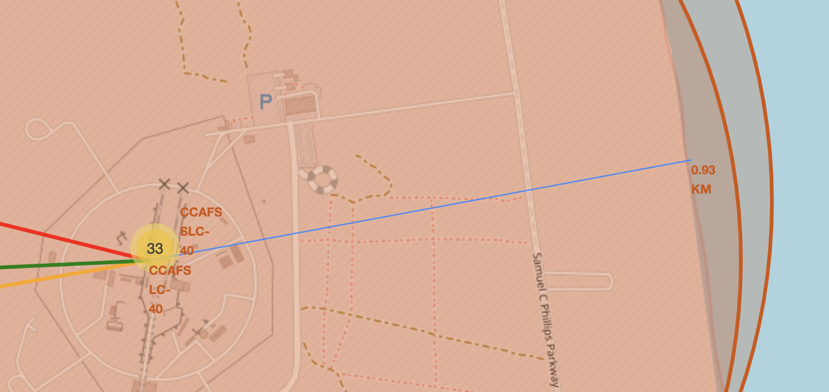
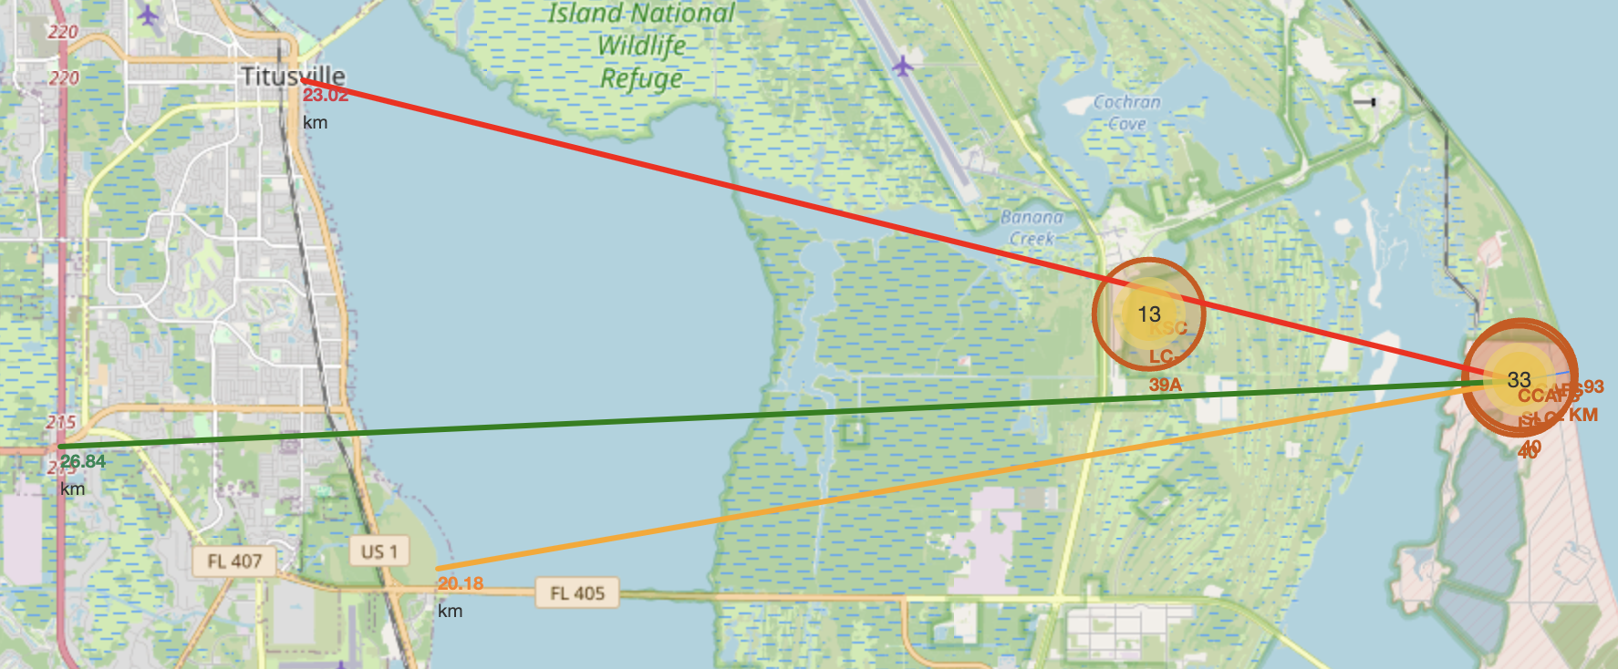
<Folium Map Screenshot 3>
Replace <Folium map screenshot 3> title with an appropriate title
Explore the generated folium map and show the screenshot of a selected launch site to its proximities such as railway, highway, coastline, with distance calculated and displayed
Explain the important elements and findings on the screenshot

Slide 38

Section 4

Slide 39
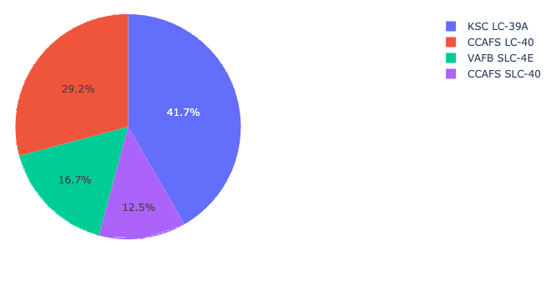
Total success launches by site
KSC LC-39A had the most successful launches from all the sites.

Slide 40
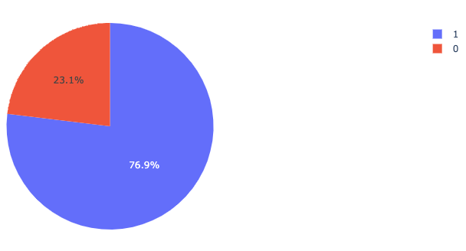
Launch-success ratio for KSC LC-39A
KSC LC-39 who has the highest percentage of success, achieved a 76,9% success rate while getting a 23.1% failure rate.

Slide 41
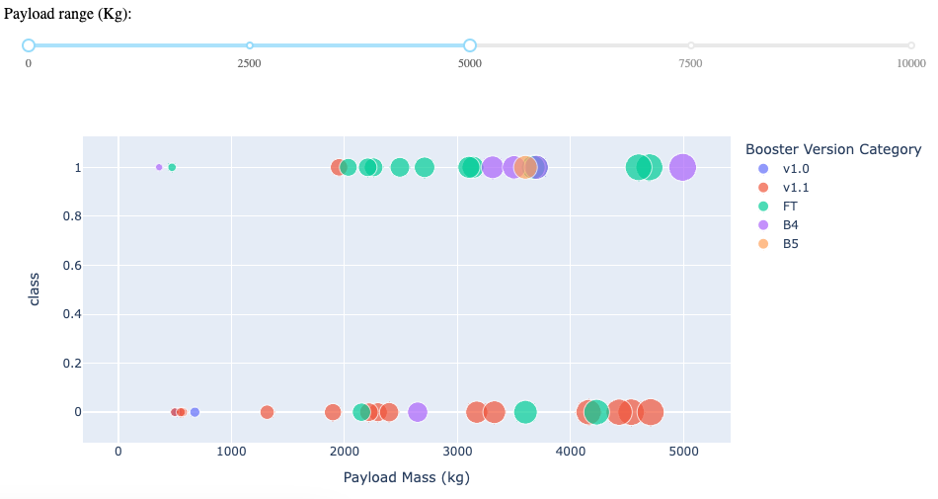
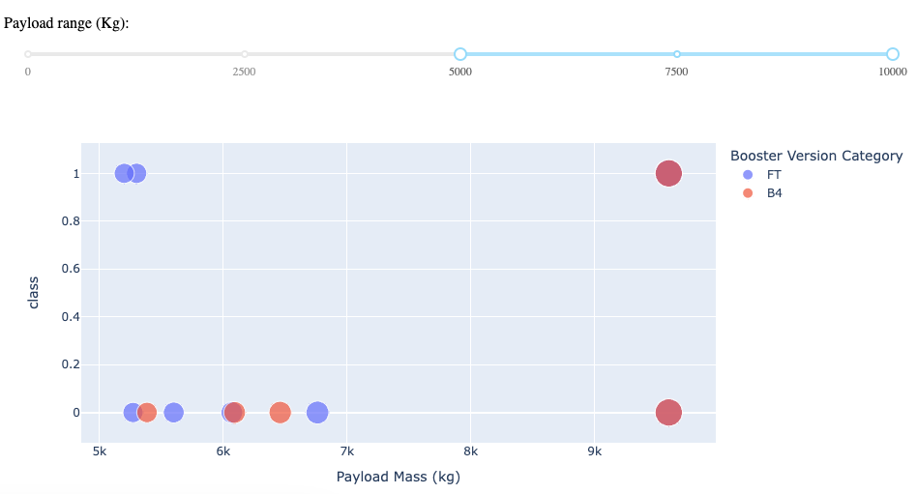
Launch Outcome vs Payload
Can be depicted that low-weight payloads have a success rate higher than heavy-weight payloads.
Low-weight Payload (0kg – 5.000kg)
Heavy-weight Payload (5.000kg-10.000kg)

Slide 42

Section 5

Slide 43
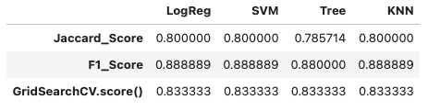
Classification Accuracy
For different models, the accuracy was scored :
LogReg: Logistic regression
SVM: Support Vector Machine
Tree: Decision tree
KNN: K-nearest neighbors
All the performed methods were similar.
The preferred to keep working in the future is the KNN:

Slide 44
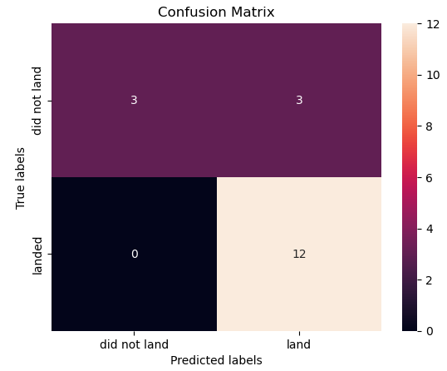
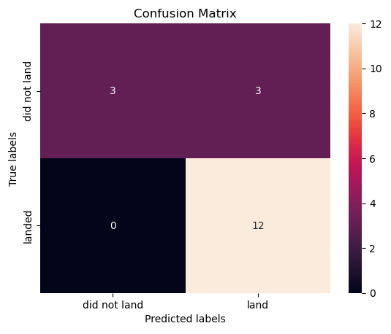

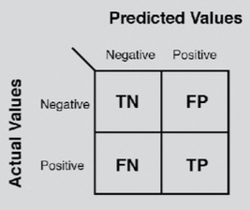
Confusion Matrix
Logistic regression
Support Vector Machine
As the accuracy tests were similar, the confusion matrices were also similar except for the decision tree which had some problems.
The biggest problem of these models is these false positives, i.e. unsuccessful landing marked as successful landing by the classifier.
Decision Tree
KNN: K-nearest neighbors

Slide 45
Conclusions
Point 1
Point 2
Point 3
Point 4
…

Slide 46
Appendix
Include any relevant assets like Python code snippets, SQL queries, charts, Notebook outputs, or data sets that you may have created during this project

Slide 47


Slide 48
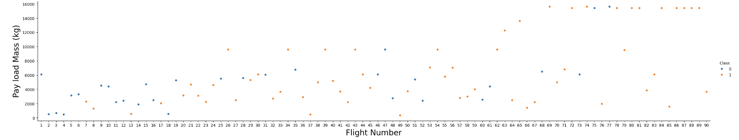
EDA with Data Visualization
Pay Load Mass vs Flight Number
Payload Mass vs Flight Number: overlay the outcome of the launch. We see that:
As the flight number increases, the first stage is more likely to land successfully.
The payload mass is also important; it seems the more massive the payload, the less likely the first stage will return.

